Slide 1
Out of the Archive
Adventures in the “Minor” Archive
Maya Gurantz, Artist
Antoinette LaFarge, Professor, UC Irvine, Artist
Audra Eagle Yun, Archivist
Notes:
Test here for Presenter Display

Slide 2
Out of the Archive
Surface the archives of forgotten artists, writers, scientists.
Encourage citizen-researchers to engage with this work; increase layman’s confidence in entering and enjoying archival research, even without a specific project in mind.
Create an easily navigable guide of best practices for citizen researchers in the archives, families maintaining personal archives (family letters, journals) or communities working with community archives.
Develop strategies to integrate such archival research in pedagogy.
Notes:
Throughout the United States are archives holding unpublished manuscripts by women and people of color whose achievements are no longer well known. Ranging from memoirs and essays to fiction and poetry, these texts offer firsthand witnesses to history written by marginalized people. Although readily accessible to librarians and scholars, they remain largely inaccessible to ordinary citizens and offer little to attract publishers in today's market. Co-organized by Antoinette and I, and funded with seed grant from the UC Humanities Research Initiative, "Out of the Archive" is a proof-of-concept working group that asked: What will it take to bring such unpublished materials to the public in an organized way?

Slide 3
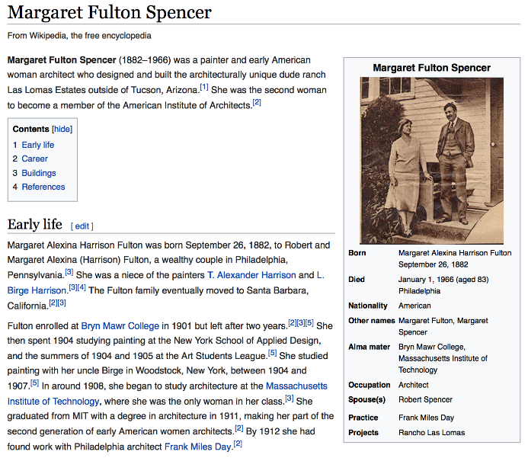
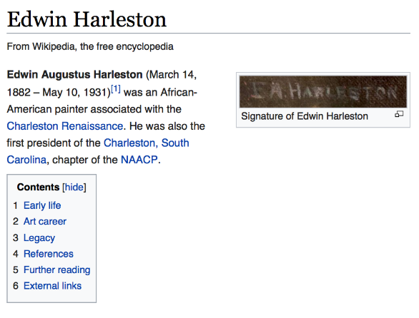
Inspirations
Notes:
"Out of the Archive" expands on Antoinette LaFarge’s ongoing efforts to recover into public awareness the lives of women and people of color from the late 19th to the early 20th centuries. Since 2013, she has written well over 200 biographical Wikipedia entries of scientists, artists, performers, activists, and writers who achieved their success despite the strong hindrances of sexism and racism. In the course of her research, she noticed that many of her subjects have an archive—often at a small college, a local historical society, or a library—and that most of these minor archives hold unpublished manuscripts. Consisting mainly of first-person narratives of contemporary events in the form of memoirs, essays, and letters, the archives also include novels, short stories, and poems that reflect on the struggles of their own times. Examples include Margaret Fulton Spencer (1882–1966), a painter and architect whose archive holds an unpublished memoir; Phebe Ann Coffin Hanaford (1829–1921), a Quaker minister and biographer whose archive holds an unpublished memoir; and Edwin Harleston (1882–1931), an African-American painter whose archive holds an unpublished biography by family members.
Preserved but largely unseen, these “minor” writings exist in limbo as far as the public is concerned. There is no way to see this unpublished literature without traveling to the archives, which puts them out of reach of nearly everyone. As the writings of undervalued people, these manuscripts do not offer much to attract mainstream publishers, and they are outside of the large-scale digitization efforts that currently focus on published books.

Slide 4
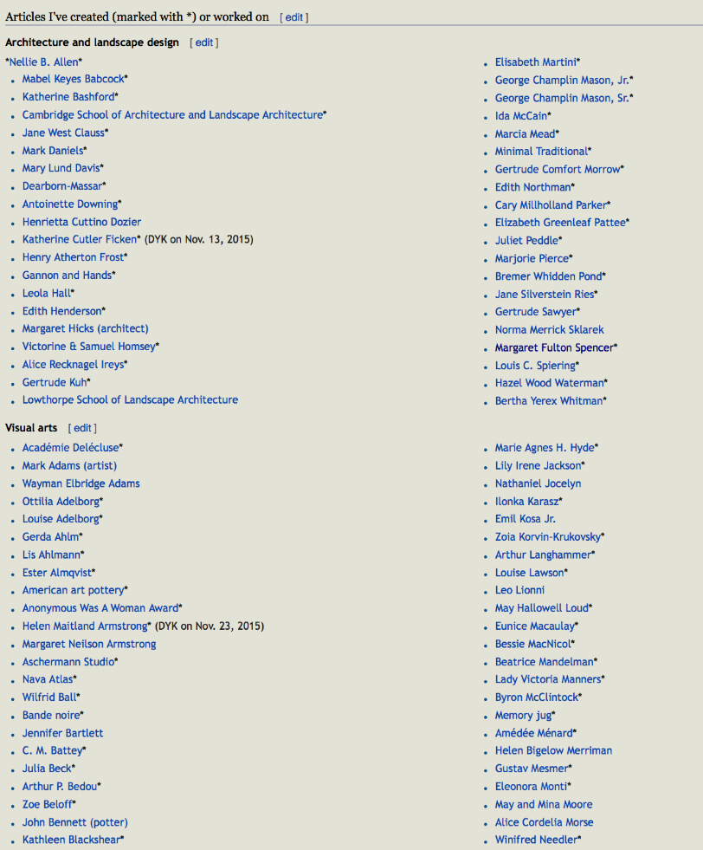
Notes:
"Out of the Archive" expands on Antoinette LaFarge’s ongoing efforts to recover into public awareness the lives of women and people of color from the late 19th to the early 20th centuries. Since 2013, she has written well over 200 biographical Wikipedia entries of scientists, artists, performers, activists, and writers who achieved their success despite the strong hindrances of sexism and racism. In the course of her research, she noticed that many of her subjects have an archive—often at a small college, a local historical society, or a library—and that most of these minor archives hold unpublished manuscripts. Consisting mainly of first-person narratives of contemporary events in the form of memoirs, essays, and letters, the archives also include novels, short stories, and poems that reflect on the struggles of their own times. Examples include Margaret Fulton Spencer (1882–1966), a painter and architect whose archive holds an unpublished memoir; Phebe Ann Coffin Hanaford (1829–1921), a Quaker minister and biographer whose archive holds an unpublished memoir; and Edwin Harleston (1882–1931), an African-American painter whose archive holds an unpublished biography by family members.
Preserved but largely unseen, these “minor” writings exist in limbo as far as the public is concerned. There is no way to see this unpublished literature without traveling to the archives, which puts them out of reach of nearly everyone. As the writings of undervalued people, these manuscripts do not offer much to attract mainstream publishers, and they are outside of the large-scale digitization efforts that currently focus on published books.

Slide 5
Inspirations
Notes:
Antoinette mentioned all of the unpublished memoirs and manuscripts—these people in their moment were both inside and outside. I was very moved by Secret Historian: The Life and Times of Samuel Steward, Professor, Tattoo Artist, and Sexual Renegade by Justin Spring, an incredible biography of an entirely forgotten French professor and his intellectual and secret queer life in the mid-20th century. Also, the mention of Tulsa Race Riots of 1921—a letter by John Hope Franklin’s father B.C. Franklin, recently donated to the A.frican American History Museum

Slide 6
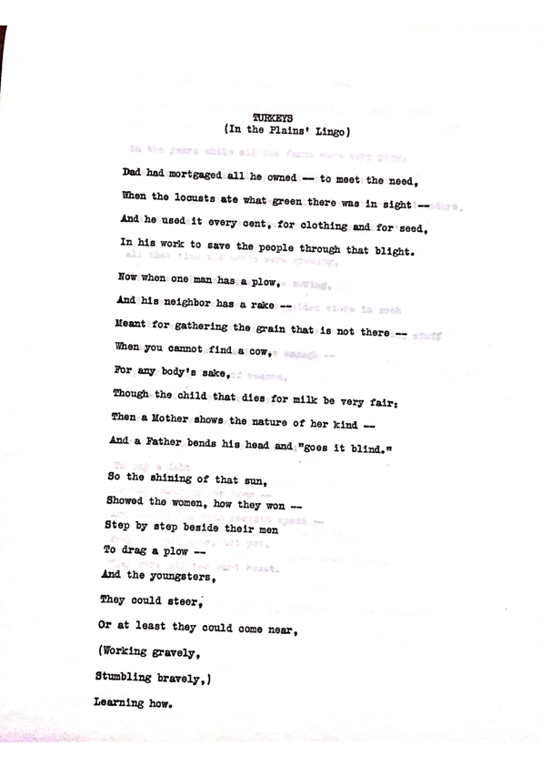
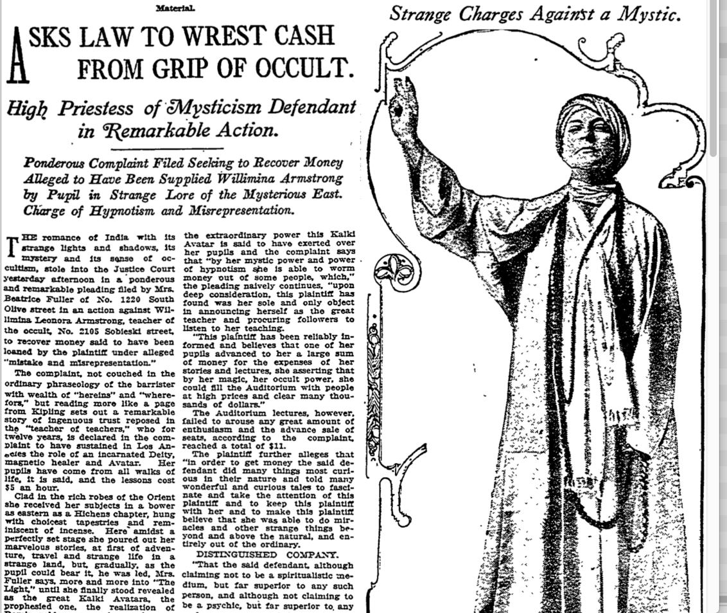
Inspirations
Notes:
From my own research project, into Willimina Armstrong, an unknown and minor figure—

Slide 7
Out of the Archive, 2017-18
Invited 5 participants—writers, journalists, artists, archivist—to do a test round into an archive of a forgotten figure?
What can each of us uncover with a quick dive?
What are the challenges?
What do we learn from the process?
Can we use our experience to create best practices?
How do we scale up the project to include more participants?
Notes:
"Out of the Archive" proposes a model intervention into selected minor archives around the United States where such unpublished works reside. The working group will attempt to bring some of these works to some form of publication and create a protocol that could be followed by citizens without institutional support or large resources. A successful trial run could point to a larger-scale effort to rescue these orphaned accounts of history in the making.
PROPOSED OBJECTIVES
"Out of the Archive" will work towards the following goals:
1. Meet virtually as a working group to select target archives, identify potential challenges, and discuss group strategies. Make first contacts with personnel at target archives. (Intermittent, June 2017 to April 2018)
2. Arrange travel dates for on-site investigations and copying/digitizing activities. (Summer 2018)
3. Meet virtually for progress reports and to create a concrete plan of action for sharing manuscripts through epublication in some form. Investigate possible partnerships with the host institutions and other appropriate nonprofit institutions that might lead to print publications in some instances. (Summer/Fall 2018)

Slide 8
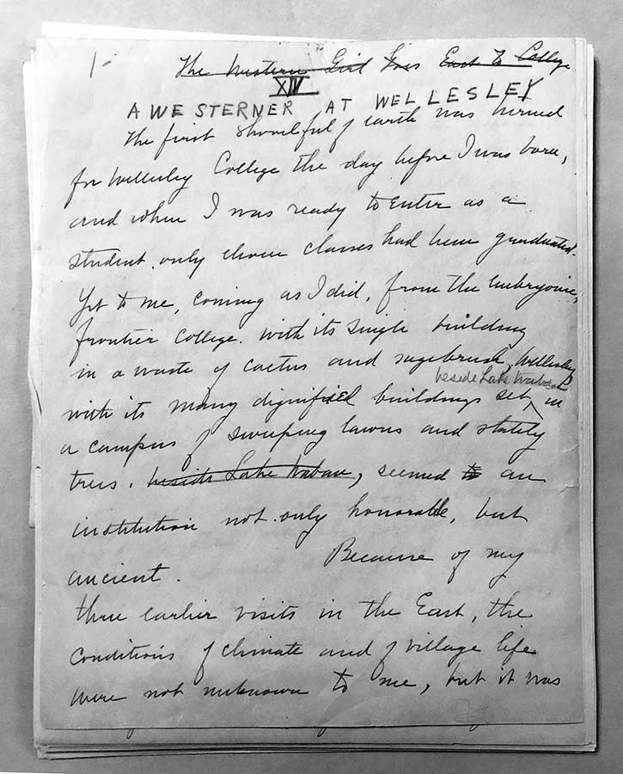
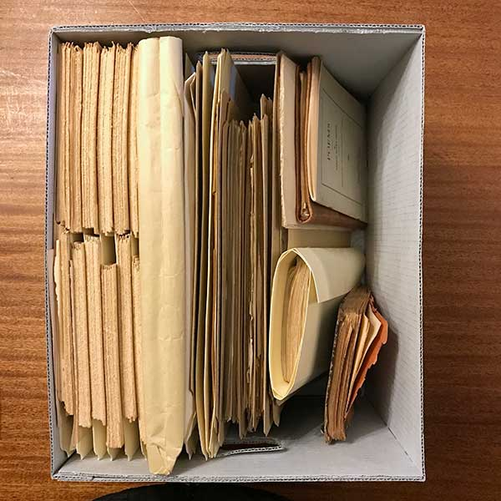
Notes:
Sarah Bixby Smith

Slide 9
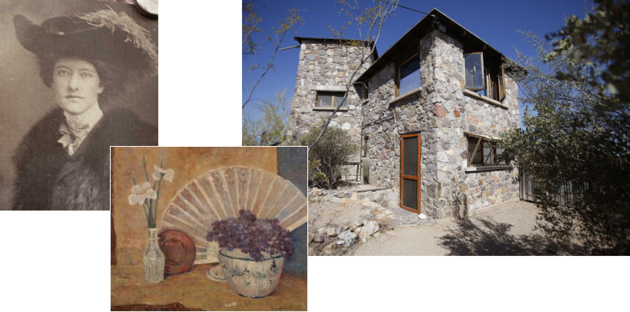
Notes:
Margaret Fulton Spencer, Dudes and Dopes

Slide 10
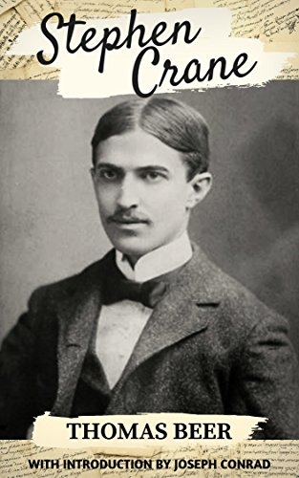
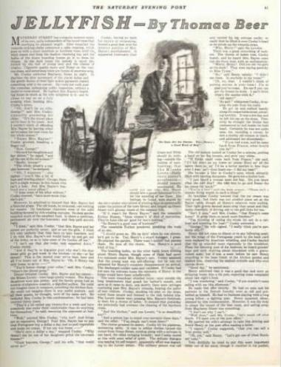
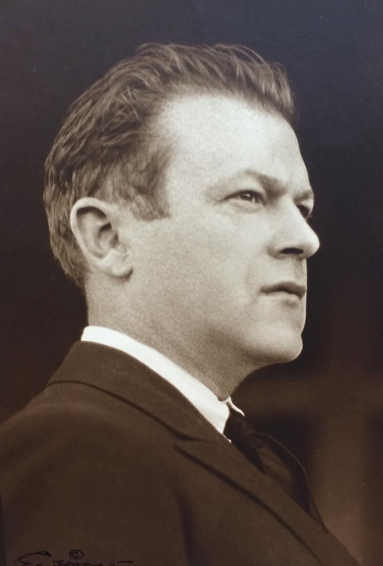
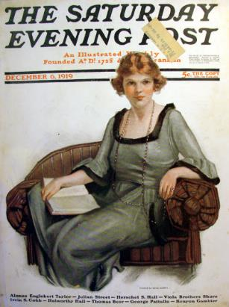
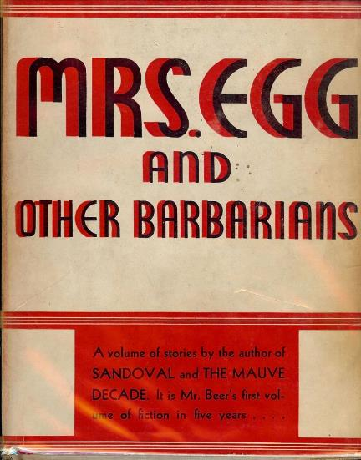
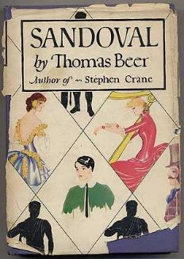
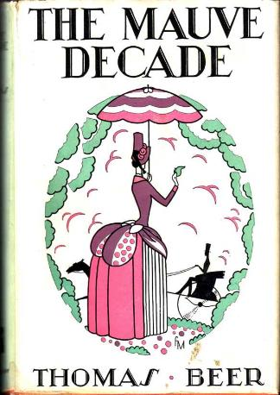

Slide 11
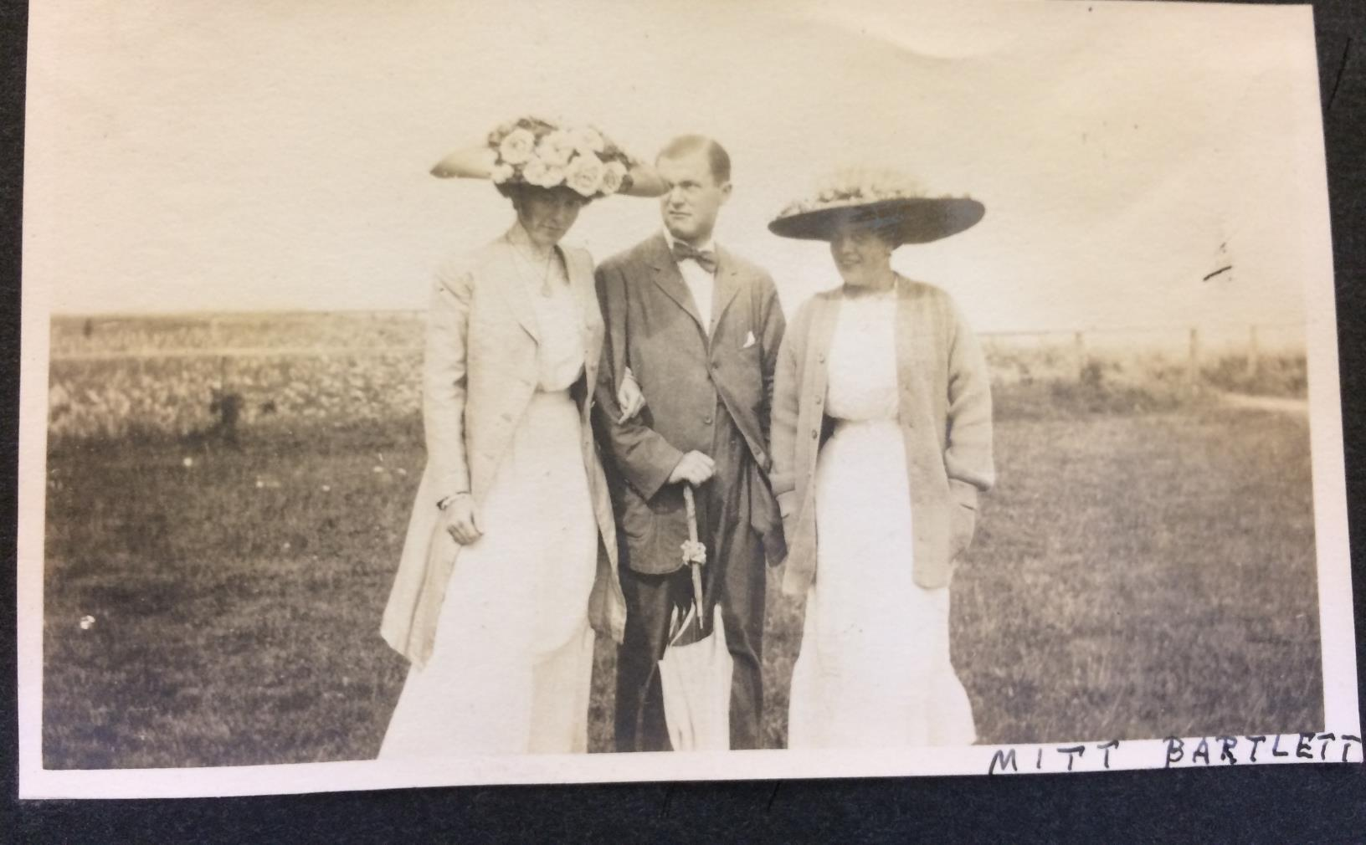
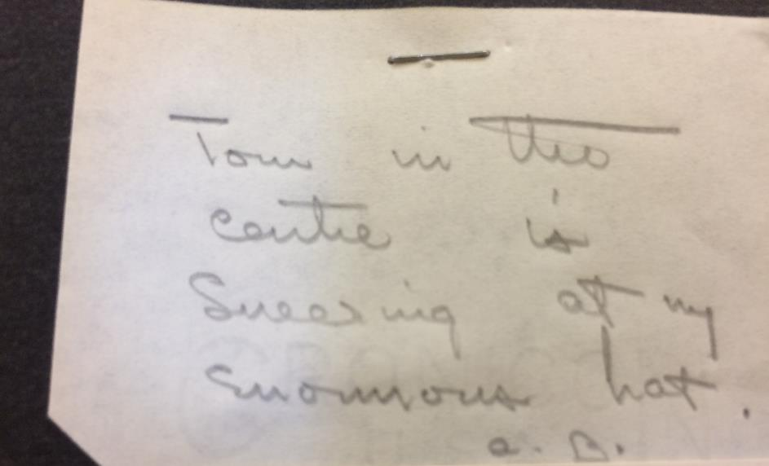
“Tom in the centre is sneering at my enormous hat.” —A.B.

Slide 12
Challenges in working with Yale’s Manuscripts & Archives:
Materials may only be reviewed in the Manuscripts and Archives Reading Room in Sterling Memorial Library on campus.
Nearly all materials are stored off-site in a facility four miles away.
Materials are only retrieved from the facility twice a day.
Materials requested after 10am were not guaranteed available until the next day, though in practice there were exceptions.
Website:
Reality:

Slide 13
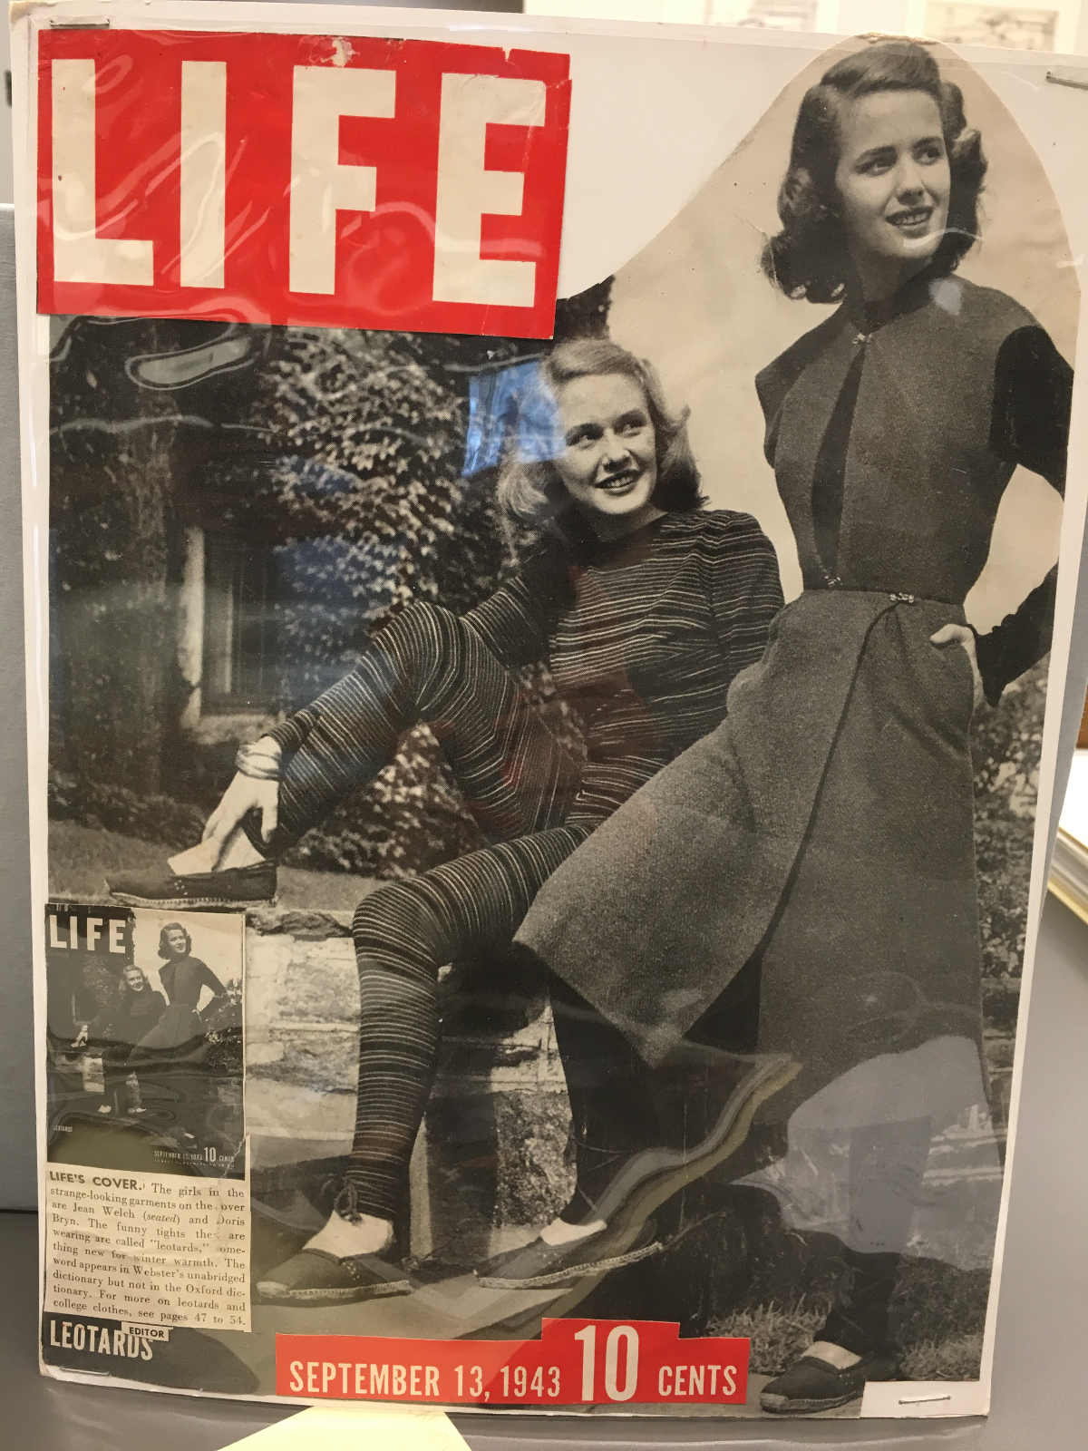
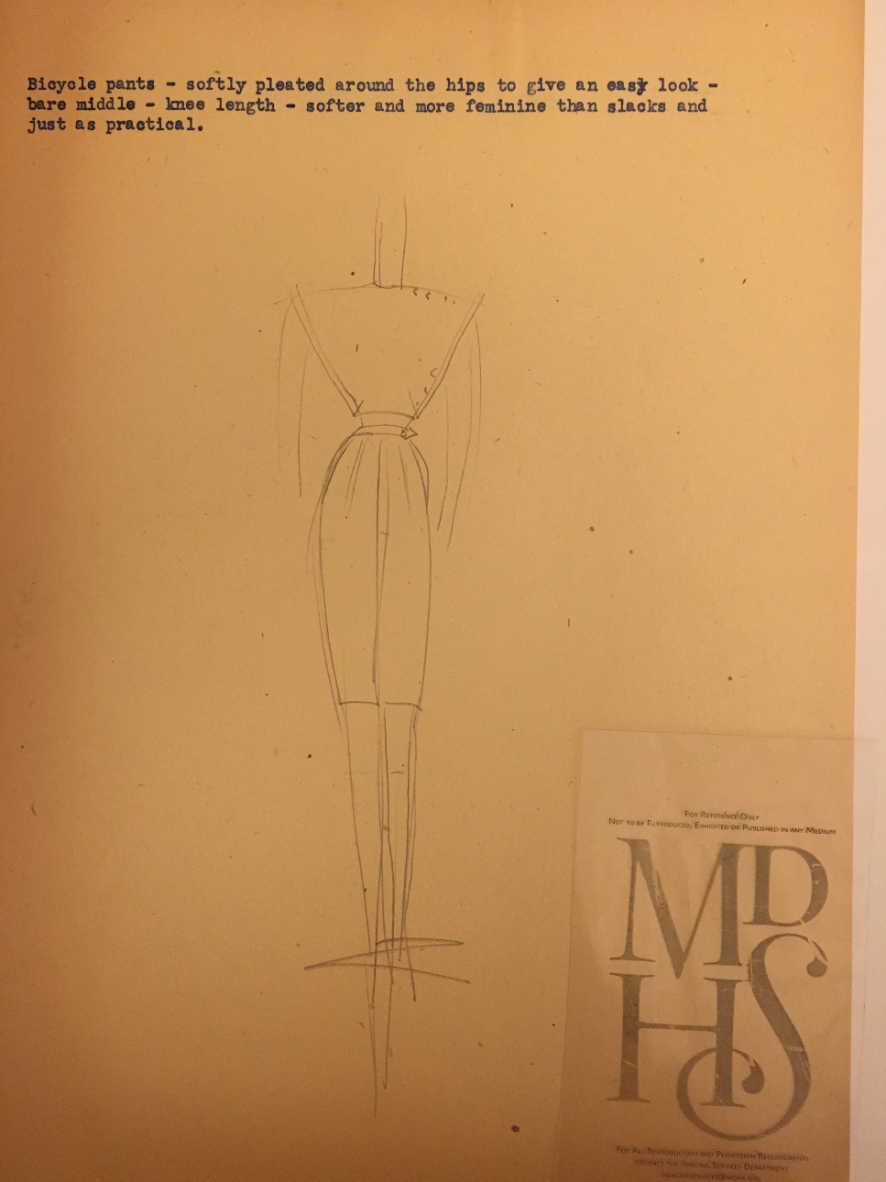
Notes:
Claire McCardell

Slide 14
Projects
“One Day, One Box”
Guides for Citizen Researcher, Family Archivists
Developing curricula in archival research for teachers

